Slide 1
GLENEAGLE SECONDARY
GRADE 12 INFORMATION SESSION

Slide 2
KEY CONTACT PEOPLE
Mr. Cober Principal
Ms. Potter-Smith Vice Principal (A-H)
Mr. Chan Vice Principal (I-P)
Ms. Cuellar Vice Principal (Q-Z)
Mr. Henry Counsellor (A-H)
Ms. Butterfield Counsellor (I-P)
Ms. Duarte Counsellor (Q-Z)
Flora Youth Worker
Ms. Yang International Youth Worker- Mandarin
Ms. Jeoung International Youth Worker- Korean
Ms. Clark Youth Worker Aboriginal Education
Ms. Austman Career Resource/scholarships
Ms. Chung Commencement
Career Life Connections
Mr. Bingley (A-H)
Mrs. Demonte (I-P)
Mrs. Wilson (Q-Z)

Slide 3
GRADUATION REQUIREMENTS
REQUIRED COURSES
Career Life Education 10
English 10
English 11
English 12
Mathematics 10
Mathematics 11 or 12
Fine Arts and/or Applied Skills 10, 11 or 12
Social Studies 10
Social Studies 11 or Comparative Cultures 12, Economics 12, History 12, Geography 12 or Law 12
Science 10
Science 11 or 12
Physical Education 10
TOTAL 48 credits

Slide 4
GRADUATION REQUIREMENTS
28 Elective credits from grade 10-12 courses
Career Life Connections (CLC) – 4 credits
Total credits is 80
Of the 80 credits for graduation, at least 16 credits must be at the grade 12 level, including English 12
Numeracy Assessment

Slide 5
PROVINCIAL EXAMS
Required Provincial Exams
English 12 40%

Slide 6
Career Life Connections
Career Life Connections
  Mr. Bingley (A-H)
  Mrs. Demonte (I-P)
  Mrs. Wilson (Q-Z)

Slide 7
Career life connections 12 & Capstone project
Mr. Bingley (A-H)
Mrs. Demonte (I-P)
Mrs. Wilson (Q-Z)

Slide 8

What you need to know…
  Each grade 12 alpha group will be added to a “Team” in “Microsoft Office 365 Teams”
  “Teams” → “Class Notebook in OneNote” → Find your assignments in the “CONTENT LIBRARY”
  There are 6 Tabs (Assignments)
  1. My BluePrint Graduation (10%)
  2. Personal Career Life Development (10%)
  3. Connections to the Community with 30hrs Work/Volunteer Experience (20%)
-Hours can start to count starting summer after Grade 9
-Hours must be completed in the Lower Mainland
-Hours CANNOT be tied to course credits (Work Ex/Leadership/Connex/Active Living/Athletic Leadership etc.)
***If uncertain whether hours are valid please contact your CLC12 alpha teacher
4. Career Life Planning (10%)
5. Core Competencies (10%)
6. Capstone Project (40%)

Slide 9
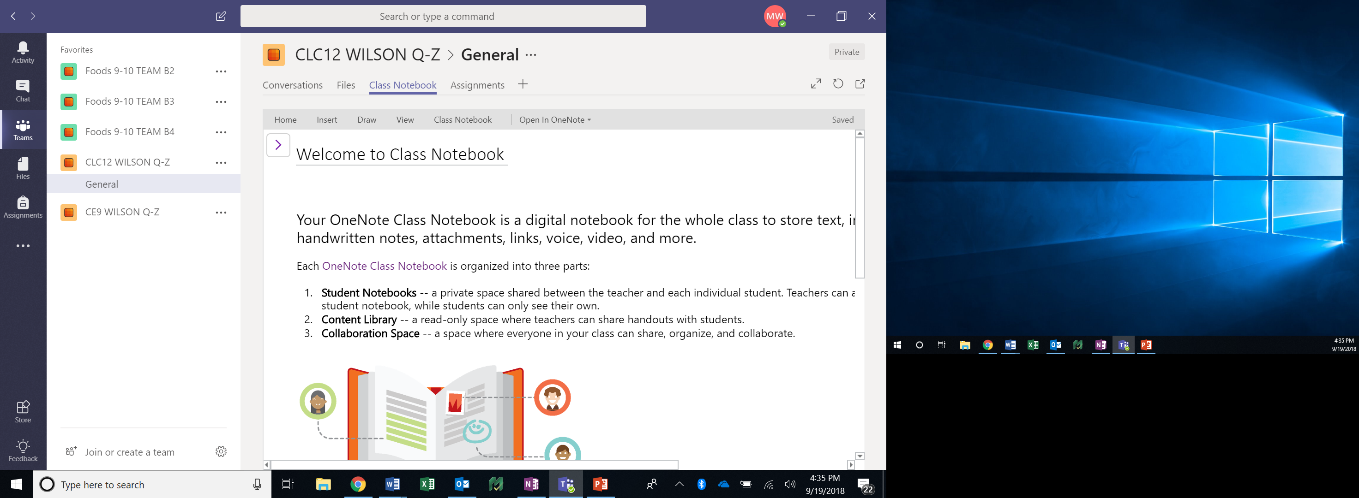
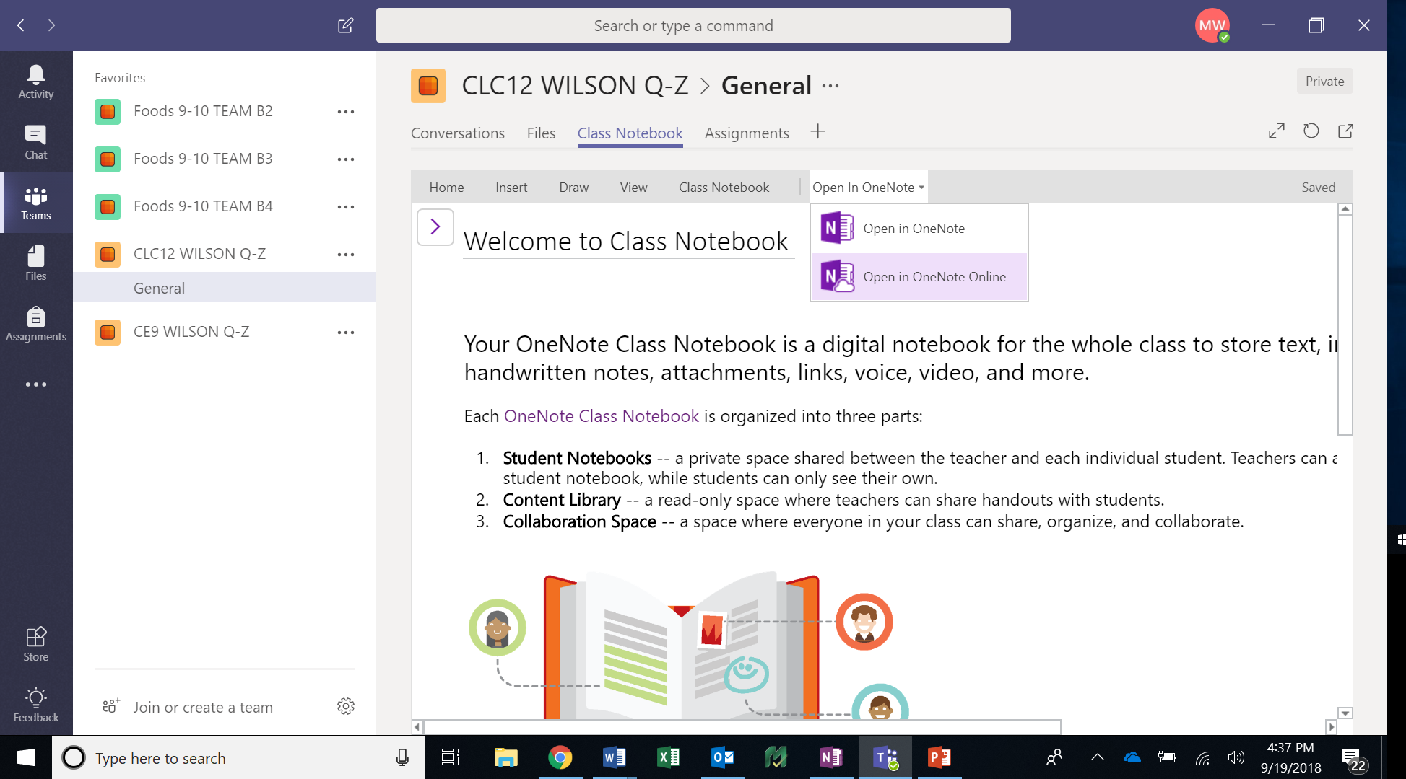
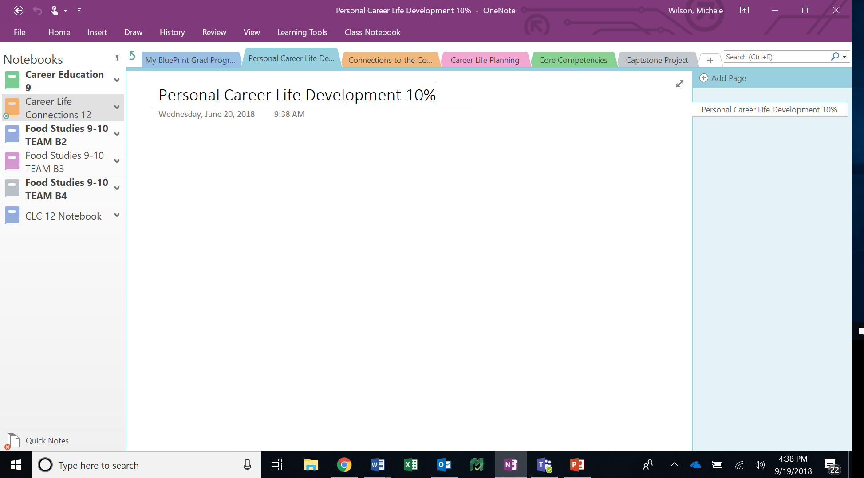
2
1
3

Slide 10

Important dates
Early Grads
Career Life Connections Assignments
DUE: Friday, December 21st
Capstone Project
DUE: Friday, Jan 11th – OR EARLIER (By appointment only with your assigned alpha teacher)
Regular Grads
Career Life Connections Assignments
DUE: Tuesday, February 19th
Capstone Project
DUE: T.B.A. (Usually Mid April-Early May)

Slide 11
Do’s & Don'ts
Read the instructions carefully for each assignment!!!!
Provide detail & reflection in your answers.
ALL assignments must be completed in order to receive credit
No one-worded answers!!!!
Assignments can only be handed in ONCE – SO…do it right the 1st time!
Your report cards will reflect your level of success/completion of the assignments

Slide 12

CLC12 & CAPSTONE INCOMPLETE?
You CANNOT go to GRAD dinner-dance if you don’t complete your CLC12 assignments and Capstone project…oh, and you CAN’T GRADUATE either!

Slide 13
POST SECONDARY REQUIREMENTS
Entrance requirements differ for each Post Secondary Institute
Check Post Secondary websites
Entrance requirements have changed
Most Post Secondary Institutes are also looking at grade 11 final marks and a personal portfolio
Look for:
Date Applications open - Some are already open
Deadlines for Applications
Admission Requirements
Check to see when online courses need to be completed by

Slide 14
POST SECONDARY INSTITUTION (PSI)
CHOICES FORM
The PSI Choices form is an online document that can be accessed by:
www.studenttranscripts.gov.bc.ca
This form gives the B.C. Ministry of Education permission to release transcript to Post Secondary Institutions.
Recommended to be completed by March
PSI Choices Assembly November 13th – CL time - MPR

Slide 15
PSI continued
Registration with the BC Student Transcripts Service gives the B.C. Ministry of Education permission to release marks to post-secondary institutions (PSIs).
Set up your account with the Student Transcripts Service:
www.studenttranscripts.gov.bc.ca
If you haven’t already done so, you will need to set up a BCeID using your PEN - prior to the November 13th assembly

Slide 16
SCHOLARSHIP INFORMATION
Contact people: Ms. Austman (Career Resource Facilitator)
Mr. Henry (School Counsellor)
Scholarship Meetings:
#1. September 26TH @ Lunch in the Library Computer Lab
#2. November 21st @ Lunch in the Library Computer Lab
#3. January 9th @ Lunch in the Library
#4. February 13th @ Lunch in the Library
SCHOLARSHIP PACKAGES DUE BY March 15TH
*Please look at the Career Center website for the most up to date information

Slide 17
POST SECONDARY INFORMATION VISITS
Post Secondary Mini Fair October 10th 6:30 – 8:00pm MPR
University of British Columbia October 22nd 6:00 – 7:00pm Library
University of Calgary October 23rd 3:45 – 4:45pm Library
University of Guelph October 24th 3:40 – 4:40pm Front Foyer
Simon Fraser University October 29th 12:10 – 12:50 Library
Western Washington November 1st 12:25 – 1:00pm Library
McGill University November 7th 7:00 – 8:30pm Heritage Woods Secondary Theatre
University of Victoria Bachelor of Commerce November 13th 12:25 – 1:00pm Library
Vancouver Institute of Media Arts November 14th 12:10 to 12:50 Library
University of Alberta November 19th 2:55 to 3:55 Library
University of Toronto November 23rd 3:45 Library

Slide 18
POST SECONDARY INSITITUTE MINI FAIR
October 10th 6:30 – 8:00 pm Gleneagle in the MPR
October 10th 6:30 - 8:00 Gleneagle in the MPR
University of the Fraser Valley
Corpus Christi College & Saint Mark’s College
BCIT
University of Northern BC
Langara College
Simon Fraser University
Trinity Western University
Thompson Rivers University
Quest University
Douglas College
Capilano University
Kwantlen Polytechnic University
University of Victoria
Vancouver Community College
Canadian Arm Forces – Royal Military College

Slide 19
AWARDS CEREMONY
Date: June 5, 2019
Time: 7:00pm
Location: Gleneagle Gym

Slide 20
VALEDICTORIAN
A GRADE 12 STUDENT IS CHOSEN FROM THE GRADUATION CLASS OF THEIR PEERS. THE CHOSEN STUDENT PREPARES A SPEECH THAT IS GIVEN TO THE GRADUATING CLASS AT THE COMMENCEMENT CEREMONY.
THE FOLLOWING CRITERIA DETERMINE A GRADE 12 STUDENT’S ELIGIBILITY FOR PARTICIPATION IN THE CHOOSING OF THE VALEDICTORIAN:
1. Good standing:
  in work habits
  in achievement
  in school citizenship
  in graduating position including having all Career Life Connections completed
2. Receive two teacher signatures to participate in the valedictorian speeches.

Slide 21
VALEDICTORIAN SELECTION
  April 29th – Valedictorian application forms available for pick - up
  May 6th – Valedictorian application forms due
  May 10th – Successful candidates will be informed
  May 16th – Valedictorian Speeches
  May 17th – Valedictorian Voting @ Lunch

Slide 22
Commencement
Date: June 15, 2019
Students arrive at 10:00am
Ceremony starts at 11:00am
Location: Queen Elizabeth Theatre
Tickets: Each student will receive 3 free tickets. If more are required a $5.00 fee per ticket is charged
All tickets must be purchased in advance
Students must be in a graduation position in order to cross the stage

Slide 23
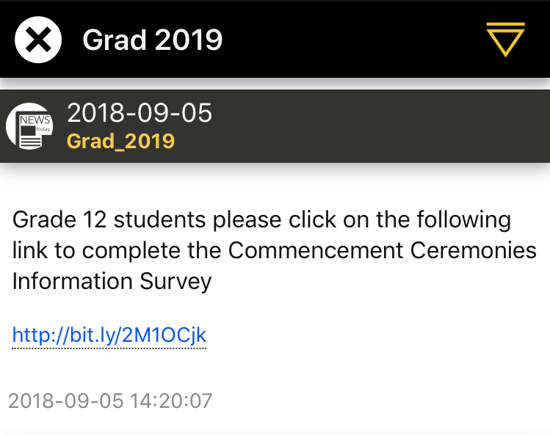
Commencement Ceremonies Information Survey
You can find a link to the survey on the GRAD CHANNEL on the Gleneagle App
https://forms.office.com/Pages/ResponsePage.aspx?id=74xl2ZICUkKZJWRC3iSkS8LNR_mX2cdFne6QmK2SYh1UOTFFMk9RRURTREdWUllETUY1SDZQR1VHOS4u
Please complete the
survey by October 15

Slide 24
GRAD DINNER & DANCE
Date: June 21, 2019
Time: 6:00 -12:00
Student must stay until 11:00pm
Location: Fairmont Hotel Vancouver
Cost: Approx. $140
Bus transportation $5
Tickets must be purchased in advance

Slide 25
AFTER GRAD
Purpose: To provide a safe and fun environment for graduating students
Date: June 22,2019
Time: Midnight – 5:30am
Students must arrive no later than 1:00am
Cost: Approx. $40
Tickets must be purchased in advance-no tickets will be sold at the door
PAC is the driving force behind After Grad- Parent volunteers are always needed.
If interested in being part of the After Grad committee
please contact Ms. Potter-Smith at:
cpottersmith@sd43.bc.ca

Slide 26
GRADUATION PHOTOS
Dates: Individual photos November 4th – 16th
Group photos October 29th
Location: Gleneagle
Students need to contact Artona directly to schedule an appointment
http://artona.com/schools/GEAG (follow links)
These photographs will appear in the yearbook and on the graduation composite

Slide 27
S-TRIPS
Gleneagle Secondary School or District #43 is not connected with nor do we support the student organized S-trips. We do not sanction or allow S-trip meetings to occur at school. The information we have about past S-trips indicates that there is a definite difference between both supervision and behavior standards for an S-trip as compared to a school authorized trip.

Slide 28
Slide Channel for App
Grad 2019
Career Centre

Slide 29
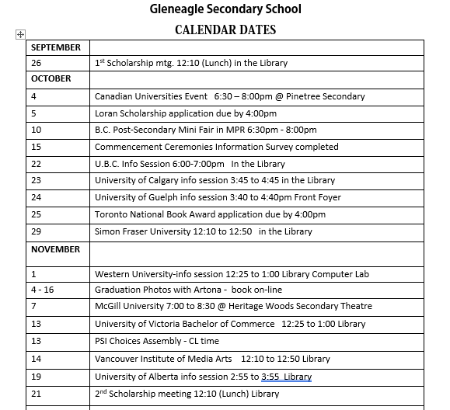

Slide 30
